Slide 1
National Workshop on Microbiome Informatics
Hands on training sessions:
Analyses of metagenomics data using R
Dr. Sudipto Saha
Associate Professor
Bose Institute, Kolkata
Paramita Roy
Senior Research Fellow
Bose Institute, Kolkata
Dibakar Roy
Senior Research Fellow
Bose Institute, Kolkata
25th September, 2024
Bose Institute, Kolkata

Slide 2
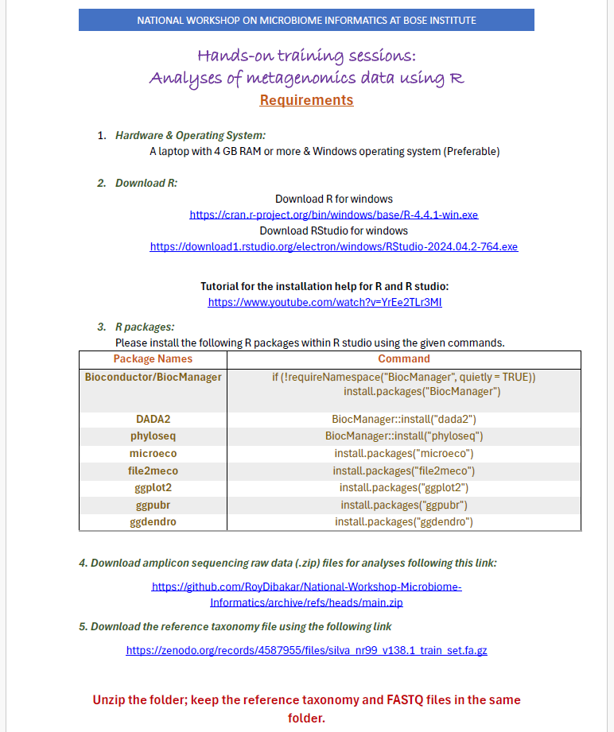

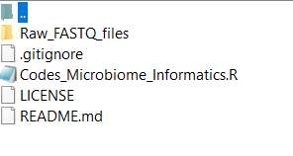
Raw FASTQ files

Slide 3
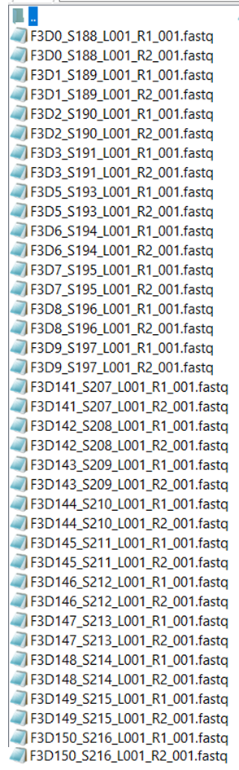
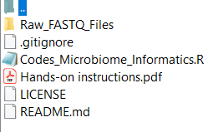
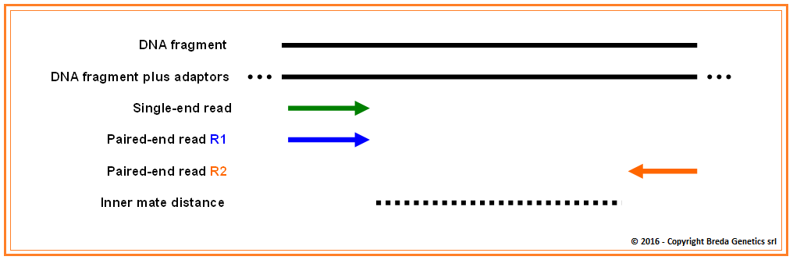
Paired-end reads
Group: Early ,post weaning
Figure 1: Sequencing of single end and paired-end reads from a DNA fragment
Group: Late, post-weaning
The reference taxonomy file should be kept in this folder along with the .fastq files.

Slide 4
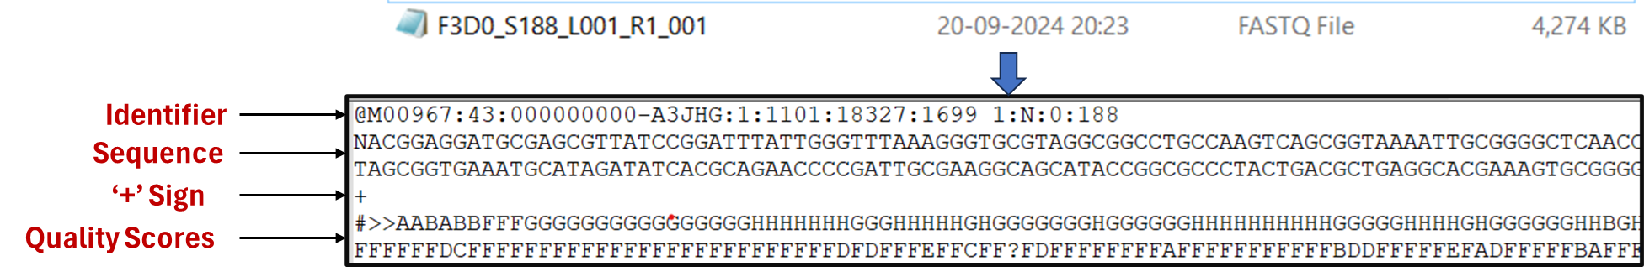
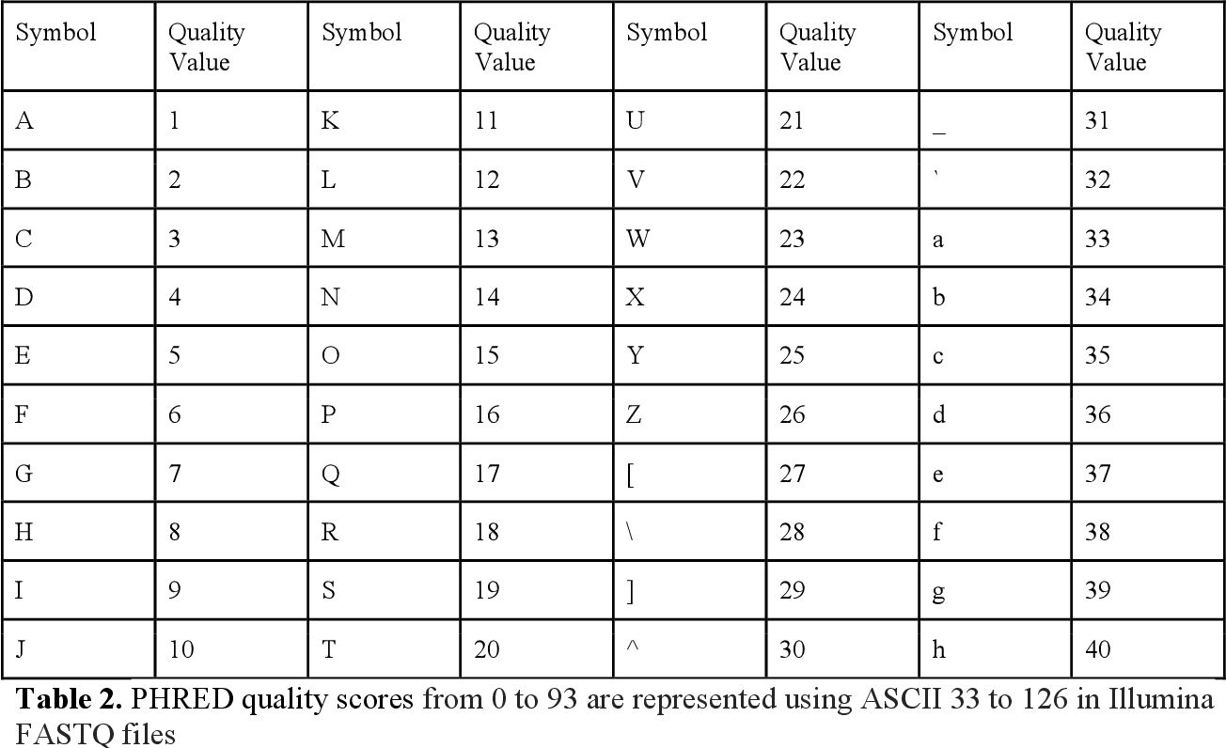
FASTQ Format Files
FASTQ format is a text base format for storing both a biological sequence (usually a nucleotide sequence and its corresponding quality scores.
Here, we are using FASTQ format files generated from Illumina Miseq amplicon sequencing of the V4 region of the 16s rRNA gene from gut samples collected longitudinally from a mouse post-weaning.
Figure 2: Snapshot of a FASTQ format file
The quality scores for the Illumina MiSeq sequencing system are as follows:
Q10 : The probability of an incorrect base call is 1 in 10, and the inferred base call accuracy is 90%
Q20: The probability of an incorrect base call is 1 in 100, and the inferred base call accuracy is 99%
Q30: The probability of an incorrect base call is 1 in 1000, and the inferred base call accuracy is 99.9%
Q30 is considered the benchmark for quality in next-generation sequencing (NGS). This is because when sequencing quality reaches Q30, almost all of the reads will be perfect.
Figure 3: Quality scores assigned to symbols

Slide 5
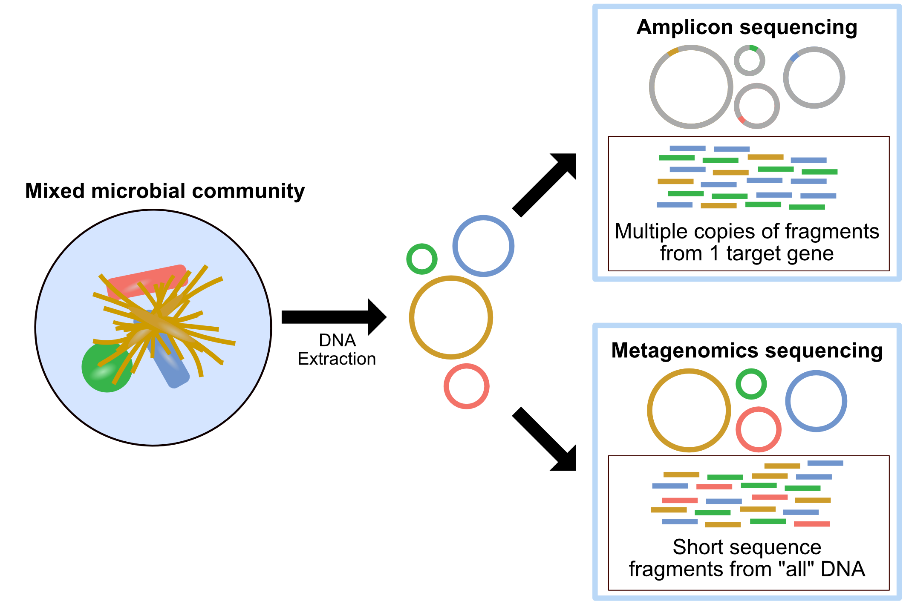


What is metagenomic data?
Metagenomics data is the result of analyzing the DNA of a community of micro-organisms in a sample without culturing them.
Advantages of using amplicon sequencing:
Faster and cheaper sequencing
Targeted analysis.
Sample size usually less, up to few megabytes (MB).
Example- F3D0_S188_L001 (~ 8 MB)
Disadvantages:
Primer bias
Functional analysis possible but with a less prediction accuracy.
Advantages of using WMS:
Taxonomic coverage upto species and strain level.
Functional analysis possible.
Disadvantages:
More expensive.
Computationally challenging.
Sample size large, up to few gigabytes (GB).
Example- SRR25204133 (~ 2 GB)
Figure 4: Sequencing technologies to characterize the metagenomic data. In Amplicon sequencing 16s rRNA region is used but in WMS all the accessible DNA of a mixed community are sequenced (adapted from https://astrobiomike.github.io/misc/amplicon_and_metagen).

Slide 6
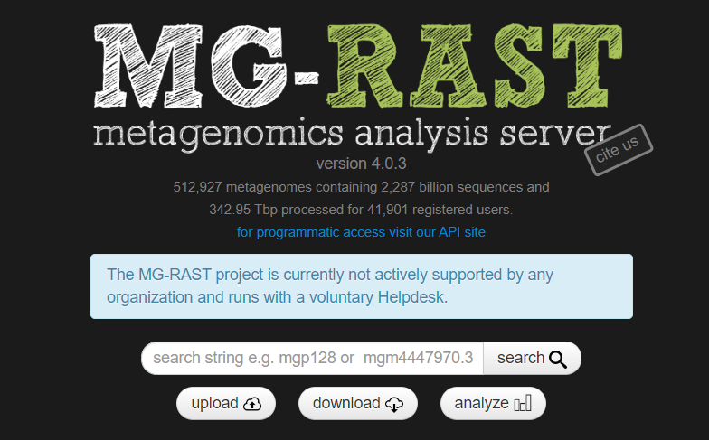


How to assess public domain data?
Metagenomics data is available in public domains such as NCBI-SRA, MG-RAST, ENA and these data can be downloaded from these platforms for further study.
Data are available as BioProjects (collection of biological data for a single study) and maximum amount of data (about 90%) is 16S amplicon data.
Figure 5: Public domains that are useful for downloading metagenomic data

Slide 7










Popular tools for metagenomic data
analysis
Amplicon data
Whole metagenomics data
mothur
Available Databases
Kraken standard database
Figure 6: Popular softwares and databases that are used in backend for metagenomic data analysis

Slide 8
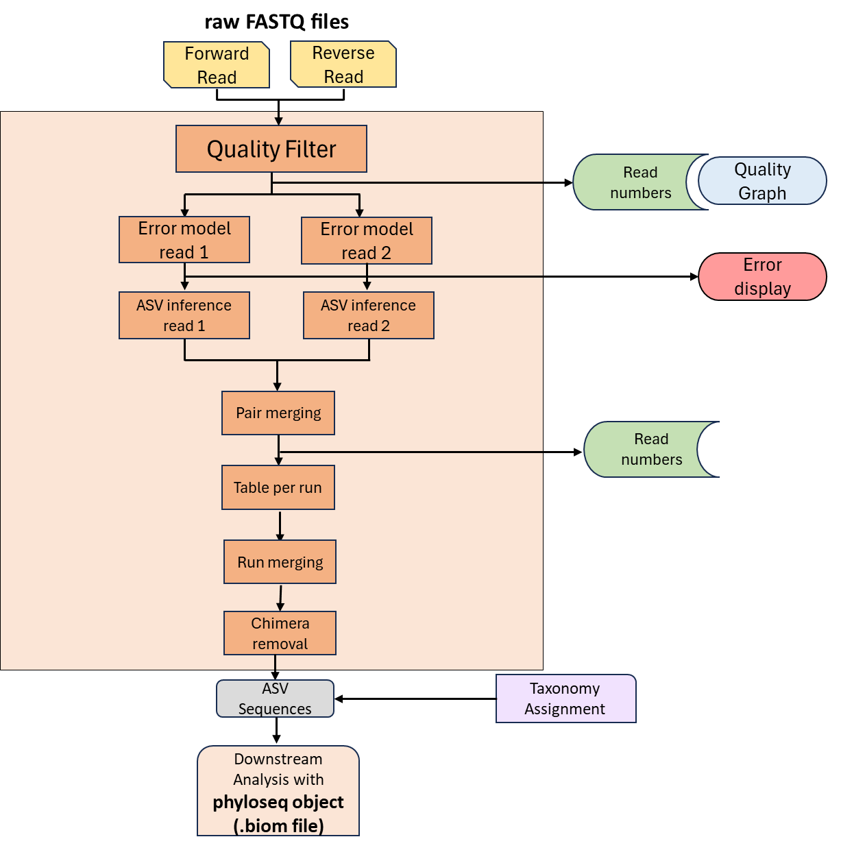
Divisive Amplicon Denoising Algorithm 2 (DADA2), by Callahan et. al. was found to be the best choice for studies requiring the highest possible biological resolution (Prodan et al, PLoS One,2020).
Figure 7: Overview of the DADA2 workflow

Slide 9
DADA2|R codes
path <- " C:/Users/Home/Desktop/Folder Name " # CHANGE the directory containing the fastq files after unzipping.
library(dada2)
# Forward and reverse fastq filenames have format: SAMPLENAME_R1_001.fastq and SAMPLENAME_R2_001.fastq
>fnFs <- sort(list.files(path, pattern="_R1_001.fastq", full.names = TRUE))
>fnFs
>fnRs <- sort(list.files(path, pattern="_R2_001.fastq", full.names = TRUE))
>fnRs
# Extract sample names, assuming filenames have format: SAMPLENAME_XXX.fastq
>sample.names <- sapply(strsplit(basename(fnFs), "_"), `[`, 1)
>sample.names
#Inspect read quality profiles
#We start by visualizing the quality profiles of the forward reads
>plotQualityProfile(fnFs[1:2])
#Now we visualize the quality profile of the reverse reads
>plotQualityProfile(fnRs[1:2])
#Filter and trim
#Assign the filenames for the filtered fastq.gz files.
# Place filtered files in filtered/ subdirectory
>filtFs <- file.path(path, "filtered", paste0(sample.names, "_F_filt.fastq.gz"))
>filtRs <- file.path(path, "filtered", paste0(sample.names, "_R_filt.fastq.gz"))
>names(filtFs) <- sample.names
>names(filtRs) <- sample.names
>filtFs
>filtRs
>out <- filterAndTrim(fnFs, filtFs, fnRs, filtRs, truncLen=c(240,160), maxN=0, maxEE=c(2,2), truncQ=2, rm.phix=TRUE, compress=TRUE, multithread=FALSE) # On Windows set multithread=FALSE
>head(out)
#Learn the Error Rates
>errF <- learnErrors(filtFs, multithread=FALSE)
>errR <- learnErrors(filtRs, multithread=FALSE)
#plotErrors(errF, nominalQ=TRUE)
#Sample Inference
>dadaFs <- dada(filtFs, err=errF, multithread=FALSE)
>dadaRs <- dada(filtRs, err=errR, multithread=FALSE)
>dadaFs[[1]]
#Merge paired reads
>mergers <- mergePairs(dadaFs, filtFs, dadaRs, filtRs, verbose=TRUE)
# Inspect the merger data.frame from the first sample
>head(mergers[[1]])
#View(mergers$F3D0)
#Construct sequence table
>seqtab <- makeSequenceTable(mergers)
# View(seqtab)
# Inspect distribution of sequence lengths
#table(nchar(getSequences(seqtab)))
#Remove chimeras
>seqtab.nochim <- removeBimeraDenovo(seqtab, method="consensus", multithread=FALSE, verbose=TRUE)
#dim(seqtab.nochim)
#sum(seqtab.nochim)/sum(seqtab)
#Track reads through the pipeline
>getN <- function(x) sum(getUniques(x))
>track <- cbind(out, sapply(dadaFs, getN), sapply(dadaRs, getN), sapply(mergers, getN), rowSums(seqtab.nochim))
# If processing a single sample, remove the sapply calls: e.g. replace sapply(dadaFs, getN) with >getN(dadaFs)
>colnames(track) <- c("input", "filtered", "denoisedF", "denoisedR", "merged", "nonchim")
>rownames(track) <- sample.names
>head(track)
#Assign taxonomy
>taxa <- assignTaxonomy(seqtab.nochim, "silva_nr99_v138.1_train_set.fa.gz", multithread=FALSE)
#Let’s inspect the taxonomic assignments:
>taxa.print <- taxa # Removing sequence rownames for display only
>rownames(taxa.print) <- NULL
>head(taxa.print)

Slide 10
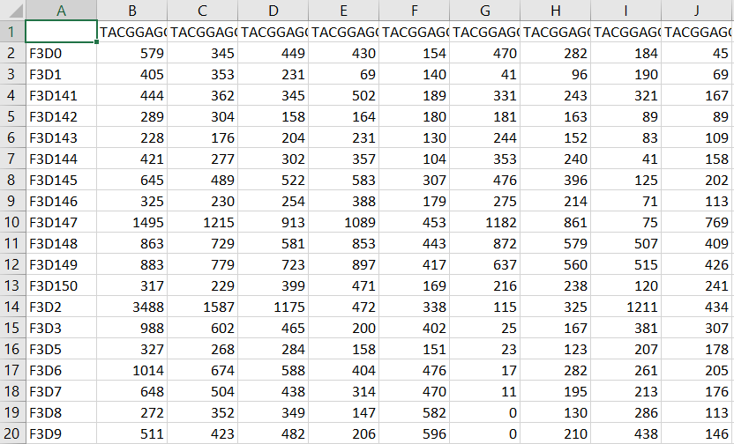
File- seqtab.nochim
This is the output file of DADA2 which will be further processed for making the phyloseq object for downstream analysis.

Slide 11
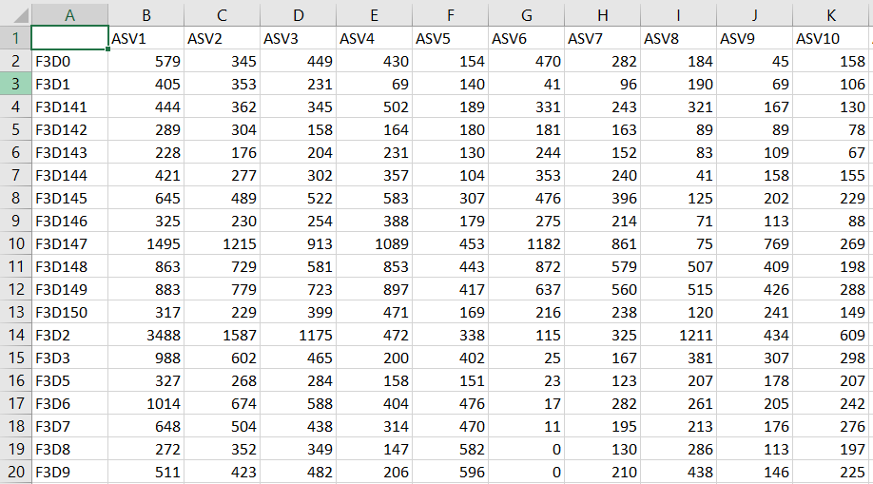
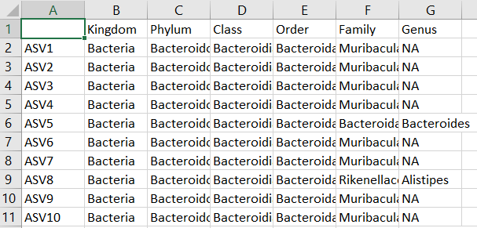
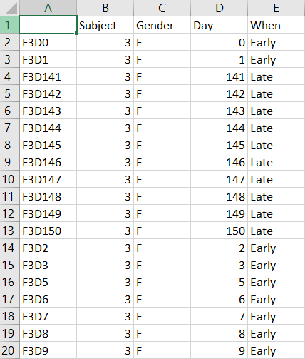
phyloseq Object(.biom file)
DADA2 outputs are processed using R package ‘phyloseq’ to a phyloseq object (.biom file) which is a data format in R that stores microbiome data in a single R object.
It’s a collection of component data classes which mainly includes:
1. OTU table
2. Taxonomy table
3. Sample metadata
This phyloseq object (.biom file) is further processed using other R packages for downstream analyses

Slide 12
Phyloseq object| R codes
path <- "" # CHANGE the directory containing the fastq files after unzipping.
#Downstream analysis
library(phyloseq)
#Generating metadata file
>samples.out <- rownames(seqtab.nochim)
>subject <- sapply(strsplit(samples.out, "D"), `[`, 1)
>gender <- substr(subject,1,1)
>subject <- substr(subject,2,999)
>day <- as.integer(sapply(strsplit(samples.out, "D"), `[`, 2))
>samdf <- data.frame(Subject=subject, Gender=gender, Day=day)
>samdf$When <- "Early"
>samdf$When[samdf$Day>100] <- "Late"
>rownames(samdf) <- samples.out
>ps <- phyloseq(otu_table(seqtab.nochim, taxa_are_rows=FALSE), >sample_data(samdf), tax_table(taxa))
>dna <- Biostrings::DNAStringSet(taxa_names(ps))
>names(dna) <- taxa_names(ps)
>ps <- merge_phyloseq(ps, dna)
>taxa_names(ps) <- paste0("ASV", seq(ntaxa(ps)))
>ps
>View(ps@otu_table)
>View(ps@tax_table)
>View(ps@sam_data)
otu_table
sam_data
tax_table

Slide 13
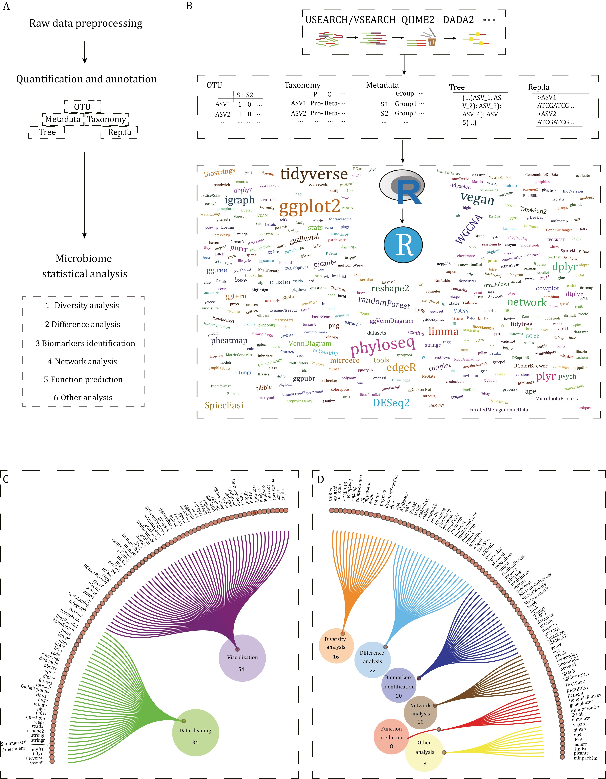
R packages for metagenomic data analysis
Packages utilized in this tutorial:
phyloseq
microeco
ggplot2
Figure 8: Popular R packages that are used for downstream analysis of metagenomics data (adapted from Wen et. al., Protein & Cell, 2023)

Slide 14
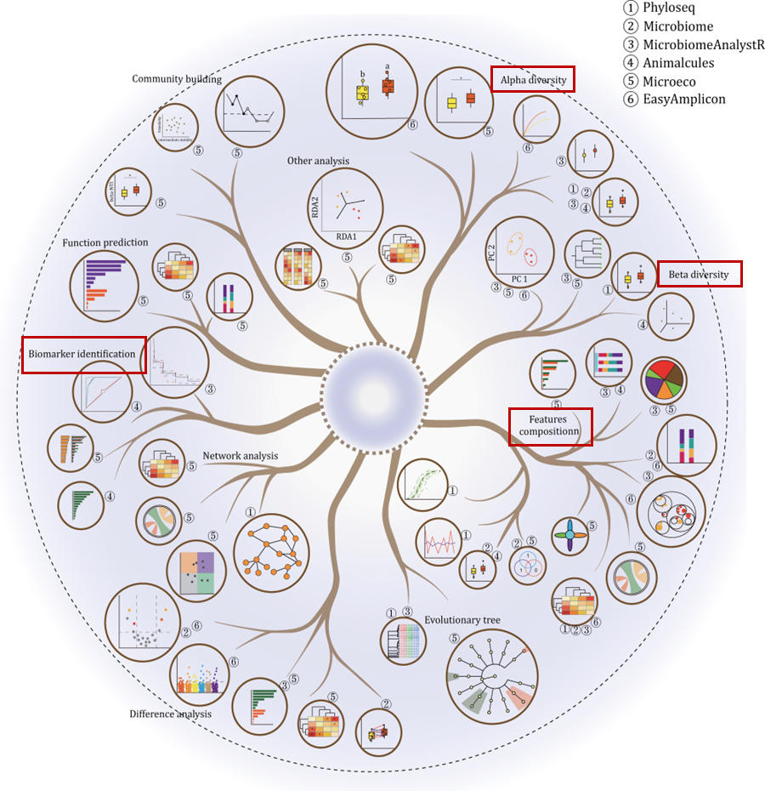
Downstream analysis using R packages
Downstream analyses in this tutorial:
Microbial Diversity (Alpha and Beta)
Microbiome Composition
Biomarker identification
Figure 9: Different types of downstream analyses of metagenomics data that are possible using R packages including Alpha diversity, Beta diversity, Feature composition and Biomarker identification (adapted from Wen et. al., Protein & Cell, 2023)

Slide 15
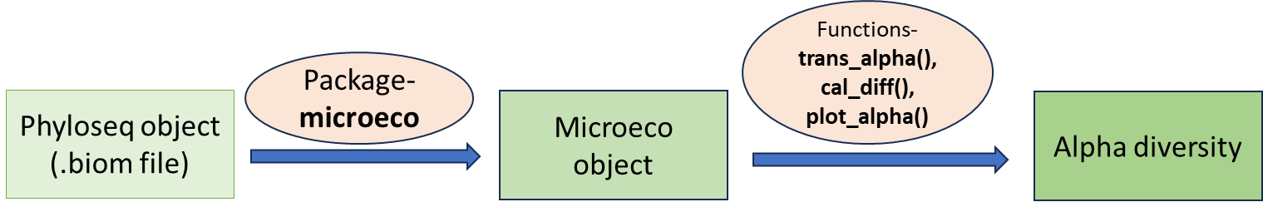
Microbial Diversity (Shannon Index)
Alpha diversity
Alpha diversity measures the diversity within a single microbial sample or environment. It provides an indication of the variety and abundance of species present in a specific sample.
Figure 10: Microbial diversity analysis. Alpha diversity plots (Shannon index)

Slide 16
Microbial Diversity|R codes
path <- "" # CHANGE the directory containing the fastq files after unzipping.
library(file2meco)
library(microeco)
library(ggplot2)
library(ggpubr)
#Alpha Diversity
t1 <- trans_alpha$new(dataset = meco_object, group = "When")
t1$cal_diff(method = "wilcox")
# y_increase: increased height for each label
t1$plot_alpha(measure = "Shannon", shape = "When", y_start = 0.1, y_increase = 0.1, xtext_size = 15) + theme(axis.text.y = element_text(size = 12, vjust = 0.5, face = "bold"), axis.text.x = element_text(size = 16, face = "bold"),panel.background = element_blank(), axis.title = element_text(size = 12, face = "bold"), axis.line = element_line(colour = "black"), legend.text = element_text(size = 12))
ggsave("alpha.tiff", height = 6, width = 6, dpi = 700)
Figure: alpha.tiff

Slide 17
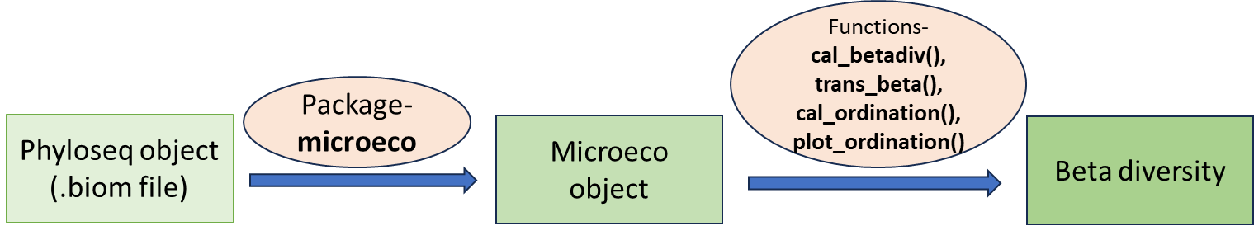
Microbial Diversity (Beta)
Beta diversity
Beta diversity measures the diversity between different microbial communities or environments. It assesses the differences in the species composition and abundance between samples.
Figure 11: Beta diversities are represented as principal coordinate (PCoA) plots of bray-Curtis distance.

Slide 18
Microbial Diversity|R codes
path <- "" # CHANGE the directory containing the fastq files after unzipping.
library(file2meco)
library(microeco)
library(ggplot2)
#Beta Diversity.
>meco_object$cal_betadiv()
>t2 <- trans_beta$new(dataset = meco_object, group = "When", measure = "bray")
# PCoA, PCA, DCA and NMDS are available
>t2$cal_ordination(method = "PCoA")
# plot the PCoA result with confidence ellipse
>t2$plot_ordination(plot_color = "When", plot_shape = "When", plot_type = c("point", "ellipse")) + theme(axis.text.y = element_text(size = 12, vjust = 0.5, face = "bold"), axis.text.x = element_text(size = 16, face = "bold"),panel.background = element_blank(), axis.title = element_text(size = 12, face = "bold"), axis.line = element_line(colour = "black"), legend.text = element_text(size = 12))
>ggsave("beta.tiff", height = 6, width = 6, dpi = 700)
Figure: beta.tiff

Slide 19
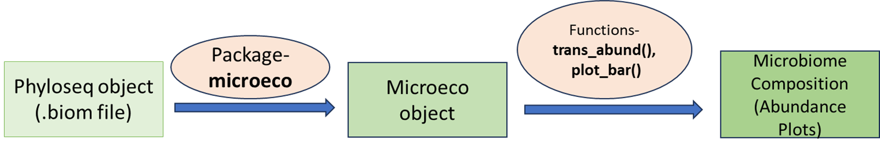
Microbiome Composition
Microbial composition analysis mainly used to display the abundance of microbes.
This compositional data are usually normalized to relative abundance, counts per million.
A.
B.
Figure 12: : Microbial abundance profile of top 10 genera. The data is normalized to relative abundance. A. The figure shows sample wise relative abundance and B. The figure shows group mean abundance.

Slide 20
Microbiome Composition|R codes
path <- "" # CHANGE the directory containing the fastq files after unzipping.
library(file2meco)
library(microeco)
library(ggplot2)
#Microbial composition
>t4 <- trans_abund$new(dataset = meco_object, taxrank = "Genus", ntaxa = 10)
>t4$plot_bar(others_color = "grey70", facet = "When", xtext_keep = FALSE, legend_text_italic = TRUE)
>ggsave("Abundance_sample_wise.tiff", height = 6, width = 10, dpi = 700)
Figure: Abundance_sample_wise.tiff

Slide 21
Microbiome Composition|R codes
path <- "" # CHANGE the directory containing the fastq files after unzipping.
library(file2meco)
library(microeco)
library(ggplot2)
# The groupmean parameter can be used to obtain the group-mean barplot.
>t5 <- trans_abund$new(dataset = meco_object, taxrank = "Genus", ntaxa = 10, groupmean = "When")
g1 <- t5$plot_bar(bar_full = FALSE, legend_text_italic = TRUE)+theme(axis.text.y = element_text(size = 12, vjust = 0.5, face = "bold"), axis.text.x = element_text(size = 16, face = "bold"),panel.background = element_blank(), axis.title = element_text(size = 12, face = "bold"), axis.line = element_line(colour = "black"), legend.text = element_text(size = 12))
>g1
>ggsave("Abundance_Bar.tiff", height = 6, width = 6, dpi = 700)
Figure: Abundance_Bar.tiff

Slide 22
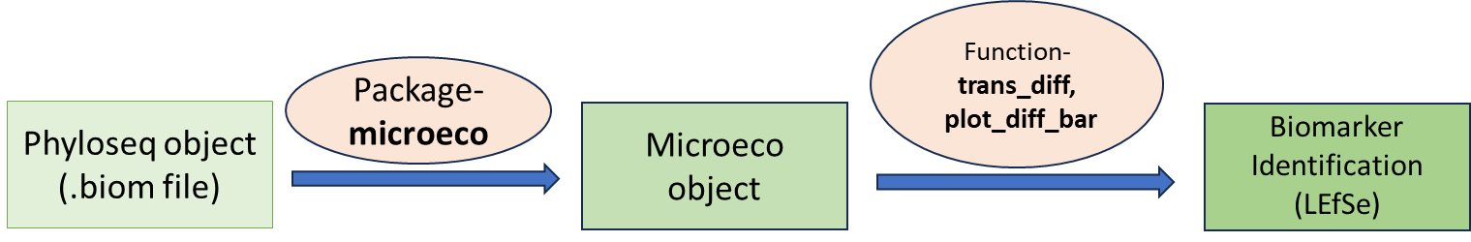
Biomarker Identification
LEfSe: Lda (linear discriminant analysis) Effective Size (LEfSe) is a biomarker discovery and explanation tool for high-dimensional data. It couples statistical significance with biological consistency and effect size estimation
Figure 13: Differential microbial genera between the groups. The divergent bar plot represents the microbial genera predicted by LEfSe (log 10 (LDA Score) ≥ 2, and P-value (fdr) < 0.05).

Slide 23
Biomarker Identification|R codes
path <- "" # CHANGE ME to the directory containing the fastq files after unzipping.
library(file2meco)
library(microeco)
library(ggplot2)
#Differential analysis
#LEfSE
>t6 <- trans_diff$new(dataset = meco_object, method = "lefse", group = "When", alpha = 0.05, lefse_subgroup = NULL, taxa_level = "Genus", p_adjust_method = "fdr")
# see t1$res_diff for the result
# From v0.8.0, threshold is used for the LDA score selection.
>g2 <- t6$plot_diff_bar(threshold = 2)
>g2
>ggsave("LDA.tiff", height = 6, width = 10, dpi = 700)
Figure: LDA.tiff

Slide 24
Thank you..
Let us move to the hands on session….

